Slide 1
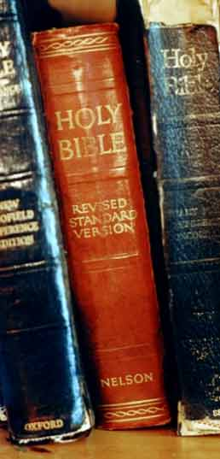
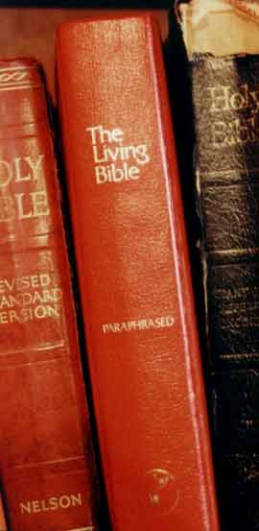

Why
King James Version?

Slide 2

And [the serpent] said unto the woman, Yea, hath God said, Ye shall not eat of every tree of the garden?
(Doubt God’s Word)
Genesis 3:1

Slide 3
The words of the LORD are pure words: as silver tried in a furnace of earth, purified seven times. Thou shalt keep them, O LORD, thou shalt preserve them from this generation for ever.
Psalm 12: 6-7 KJV
And the words of the LORD are flawless: like silver purified in a furnace of clay, purified seven times. O LORD, you will keep us safe and protect us from such people forever.
?
Psalm 12: 6-7 NIV

Slide 4
Careful copies made and spread around the world.
10 months to write one.
Over 5000 copies (known as Textus Receptus) are found to agree in nearly all but spelling, and translated to English.
Erasmus-1516
Luther-1522
Tyndale-1525
Geneva-1560
KJV-1611
New Testament books written
There are about 36,000 differences between KJV and modern versions
500
1000
1500
2000
Life of Christ
Alexandrian cult arises in Egypt, 240 A.D. and makes their own version of the “bible” making about 6,000 changes.
Origen (184-254 AD) is primary proponent.
Notes:
Professor Anthony Hort, co-worker with Professor Brooke Westcott (both of Cambridge) who created the new Greek Text of the NIV, NASB, and other contemporary “Holy Bibles” states:
“Whatever people may say to the contrary, the American empire is a standing menace to the whole civilization of Europe, and sooner or later one or the other must perish…surely, if every Babylon or Rome were rightly cursed,, it cannot be wrong to desire and pray from the bottom of one’s hearts that the American union be shivered to pieces.”
Fenton John Anthony Hort’s Letter, Vol. 2. P.
Www.wayoflife.com -two James Molenkot and a lady were both homosexuals so they did not use sodomite in the NIV.

Slide 5

Then there arose certain of the synagogue, which is called the synagogue of the Libertines, and Cyrenians, and Alexandrians, and of them of Cilicia and of Asia, disputing with Stephen.
First mention of Alexandria.
Acts 6:9

Slide 6
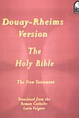
Carefull copies made and spread around the world.
10 months to write one.
Over 5000 copies (known as Textus Receptus) are found to agree in nearly all but spelling, and translated to English.
Erasmus-1516
Luther-1522
Tyndale-1525
Geneva-1560
KJV-1611
New Testament books written
There are about 36,000 differences between KJV and modern versions
500
1000
1500
2000
Life of Christ
Douay English translation of Latin Vulgate is made in 1582. This is still the official Catholic version.
Westcott and Hort Greek NT is made from Alexandrian in 1875.
English translations of this include:
Revised Version-1881
American Standard-1901
Revised Standard-1946
New World (JW)-1950
New Amer. Std.-1960
Good News, Amplified, Living, NIV*
Alexandrian cult arises in Egypt, 240 A.D. and makes their own version of the “bible” making about 6,000 changes.
Origen (184-254 AD) is primary proponent.
A few copies of the Alexandrian “bible” are made. (3- Sinaiticus & Vaticanus and Alexandrus from 350 AD still exist.)
Latin Vulgate translation is made from these in 380 AD.
Notes:
Professor Anthony Hort, co-worker with Professor Brooke Westcott (both of Cambridge) who created the new Greek Text of the NIV, NASB, and other contemporary “Holy Bibles” states:
“Whatever people may say to the contrary, the American empire is a standing menace to the whole civilization of Europe, and sooner or later one or the other must perish…surely, if every Babylon or Rome were rightly cursed,, it cannot be wrong to desire and pray from the bottom of one’s hearts that the American union be shivered to pieces.”
Fenton John Anthony Hort’s Letter, Vol. 2. P.
Www.wayoflife.com -two James Molenkot and a lady were both homosexuals so they did not use sodomite in the NIV.

Slide 7
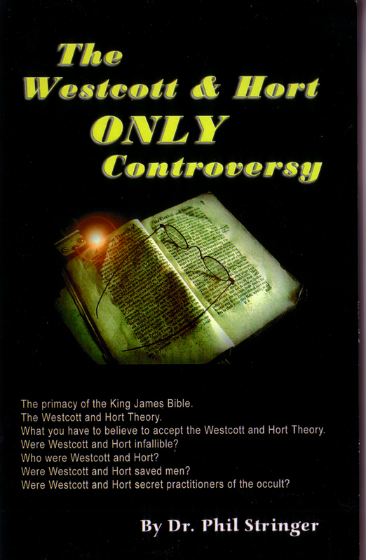
Professor Anthony Hort, co-worker with Professor Brooke Westcott (both of Cambridge) who created the new Greek Text of the NIV, NASB, and other contemporary “Holy Bibles” states:
“Whatever people may say to the contrary, the American empire is a standing menace to the whole civilization of Europe, and sooner or later one or the other must perish…surely, if every Babylon or Rome were rightly cursed,, it cannot be wrong to desire and pray from the bottom of one’s hearts that the American union be shivered to pieces.”
Fenton John Anthony Hort’s Letter, Vol. 2. P.

Slide 8
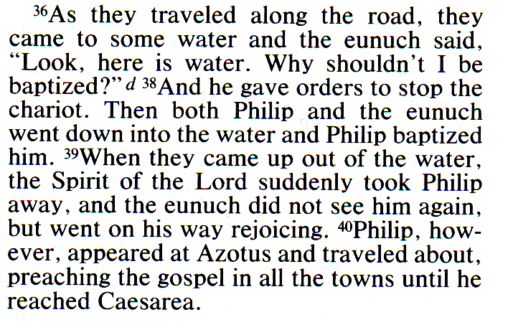
Acts 8 NIV © 1993

Slide 9
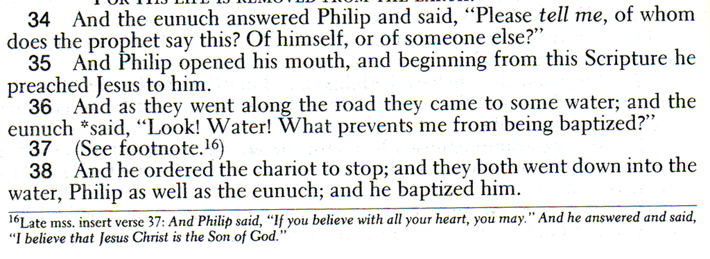
New American Standard

Slide 10
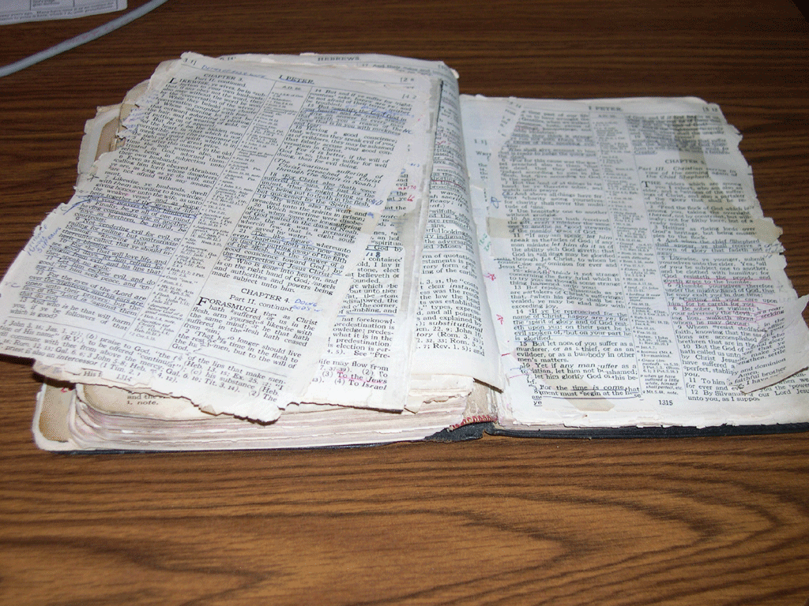
Older does not mean better! A book that is used a lot will get worn out!

Slide 11
The KJV is translated from the Textus Receptus or Received Text. Over 5000 of these exist.
Nearly all other modern translations are from the corrupt “Alexandrian Manuscripts” which include Vaticanus and Sinaticus. Westcott and Hort relied on these in 1875 for their authority.

Slide 12
There are more manuscripts of the Bible than any other book old ever written.
“Homers Iliade” a book of poetry comes in second, written in 500 B.C. only 643 manuscripts
By 1946 they had uncovered more than 24,000 manuscripts, of the Bible.

Slide 13
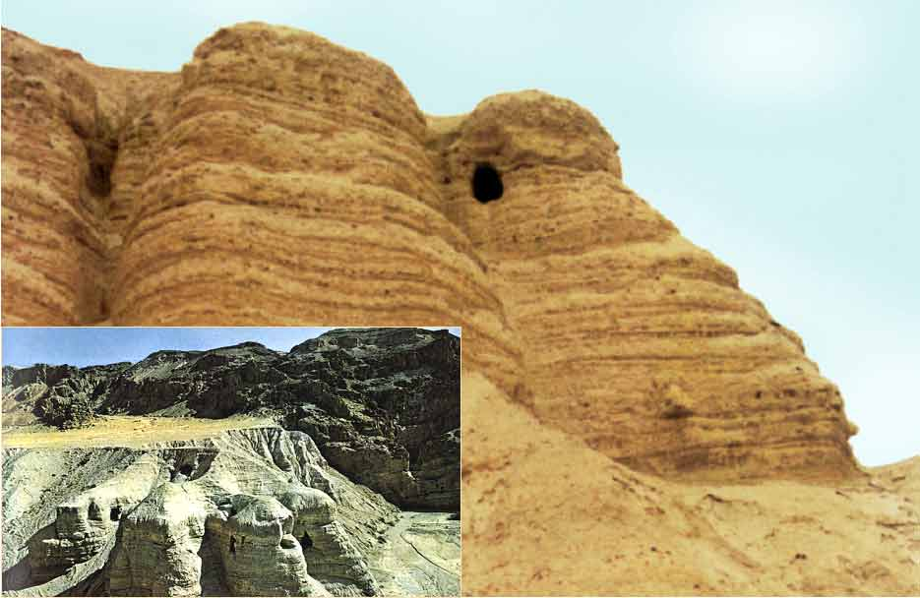
In 1947 the Dead Sea Scrolls were found in the Qumran caves.

Slide 14
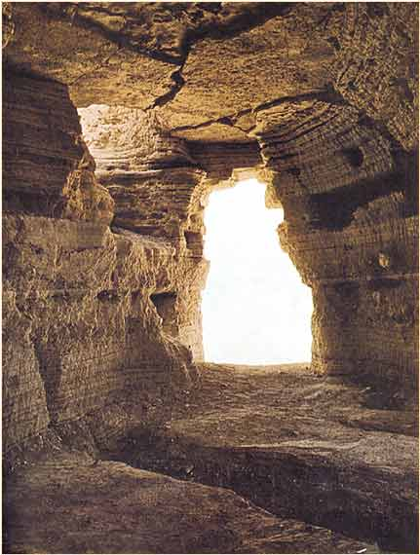
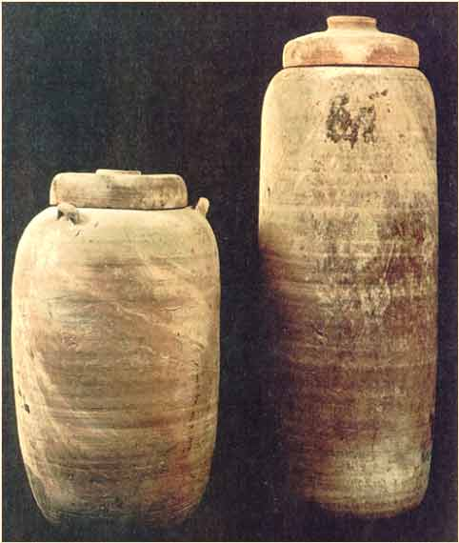
18 and 25 inches high.
There are now over 64,000 manuscripts that support the KJV .
All the books of the Old Testament ( except Esther) 40,000 new manuscripts Dated 68 A.D.

Slide 15
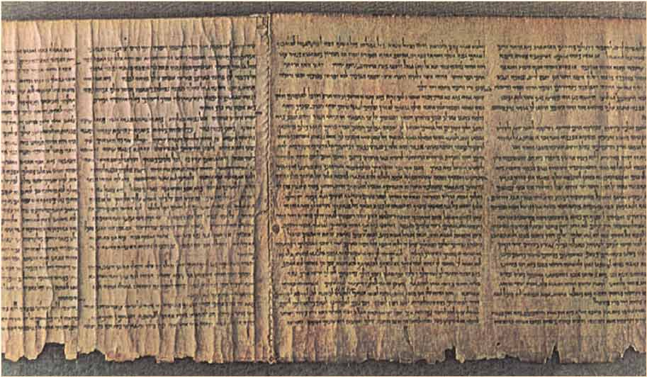
The Isaiah Scroll (dated at 100 B.C.)
1000 yrs older than the oldest known manuscript.
Notes:
Scoffers always said that the references to Jesus in Isaiah where written in after the life of Jesus. Because the oldest manuscript of Isaiah was 900 years A.D.

Slide 16
Compare the Lord’s prayer given in Luke 11 in the KJV with the one in any new version.
“When ye pray, say, Our Father which art in heaven, Hallowed be thy name. Thy kingdom come. Thy will be done, as in heaven, so in earth. 3 Give us day by day our daily bread.” Luke 11:2-3 KJV.
“When you pray, say, Father, hallowed be thy name. Thy kingdom come. 3 Give us this day…” RSV

Slide 17
Rev. 22:16
KJV
I Jesus have sent mine angel to testify unto you these things in the churches. I am the root and the offspring of David, and the bright and morning star.
NIV
I, Jesus, have sent my angel to give you this testimony for the churches. I am the Root and the Offspring of David, and the bright Morning Star

Slide 18
Rev. 2:26-28
KJV
And he that overcometh, and keepeth my works unto the end, to him will I give power over the nations: And he shall rule them with a rod of iron; as the vessels of a potter shall they be broken to shivers: even as I received of my Father. And I will give him the morning star.
NIV
To him who overcomes and does my will to the end, I will give authority over the nations-- He will rule them with an iron scepter; he will dash them to pieces like pottery-- just as I have received authority from my Father. I will also give him the morning star.

Slide 19
2 Pet. 1:19
KJV
We have also a more sure word of prophecy; whereunto ye do well that ye take heed, as unto a light that shineth in a dark place, until the day dawn, and the day star arise in your hearts:
NIV
And we have the word of the prophets made more certain, and you will do well to pay attention to it, as to a light shining in a dark place, until the day dawns and the morning star rises in your hearts.

Slide 20
Isa. 14:12
KJV
How art thou fallen from heaven, O Lucifer, son of the morning! how art thou cut down to the ground, which didst weaken the nations!
NIV
How you have fallen from heaven, O morning star, son of the dawn! You have been cast down to the earth, you who once laid low the nations!
When a Name of God is given to Satan, that is
BLASPHEMY

Slide 21
Compare the following: KJV/NIV
KJV
2 Sam 21:19 Who killed Goliath?
NIV
And there was again a battle in Gob with the Philistines, where Elhanan the son of Jaareoregim, a Bethlehemite, slew the brother of Goliath the Gittite, the staff of whose spear was like a weaver’s beam.
In another battle with the Philistines at Gob, Elhanan son of Jaare-Oregim the Bethlehemite killed Goliath the Gittite, who had a spear with a shaft like a weaver’s rod.

Slide 22
Compare the following: KJV/NIV
KJV
Matthew 17:21
NIV
20 And Jesus said unto them, Because of your unbelief: for verily I say unto you, If ye have faith as a grain of mustard seed, ye shall say unto this mountain, Remove hence to yonder place; and it shall remove; and nothing shall be impossible unto you. 21 Howbeit this kind goeth not out but by prayer and fasting. 22 And while…
20 He replied, “Because you have so little faith. I tell you the truth, if you have faith as small as a mustard seed, you can say to this mountain, ‘Move from here to there’ and it will move. Nothing will be impossible for you.” 21 22 When they…

Slide 23
Compare the following: KJV/NIV
KJV
Matthew 18:11
NIV
10 Take heed that ye despise not one of these little ones; for I say unto you, That in heaven their angels do always behold the face of my Father which is in heaven. 11 For the Son of man is come to save that which was lost. 12 How think ye? If…
10 “See that you do not look down on one of these little ones. For I tell you that their angels in heaven always see the face of my Father in heaven. 11 12 What do you think? If…”

Slide 24
Compare the following: KJV/NIV
KJV
Matthew 23:14
NIV
13 But woe unto you, scribes and Pharisees, hypocrites! for ye shut up the kingdom of heaven against men: for ye neither go in yourselves, neither suffer ye them that are entering to go in. 14 Woe unto you, scribes and Pharisees, hypocrites! for ye devour widows’ houses, and for a pretence make long prayer: therefore ye shall receive the greater damnation. 15 Woe unto you…
13 “Woe to you, teachers of the law and Pharisees, you hypocrites! You shut the kingdom of heaven in men’s faces. You yourselves do not enter, nor will you let those enter who are trying to. 14 15 Woe to you,…”

Slide 25
Compare the following: KJV/NIV
KJV
Mark 7:16
NIV
15 There is nothing from without a man, that entering into him can defile him: but the things which come out of him, those are they that defile the man. 16 If any man have ears to hear, let him hear. 17 And when he was entered…
15 Nothing outside a man can make him ‘unclean’ by going into him. Rather, it is what comes out of a man that makes him ‘unclean.’” 16 17 After he had left…

Slide 26
Compare the following: KJV/NIV
KJV
Mark 9:44
NIV
43 And if thy hand offend thee, cut it off: it is better for thee to enter into life maimed, than having two hands to go into hell, into the fire that never shall be quenched: 44 Where their worm dieth not, and the fire is not quenched. 45 And if…
43 If your hand causes you to sin, cut it off. It is better for you to enter life maimed than with two hands to go into hell, where the fire never goes out. 44 45 And if…

Slide 27
Compare the following: KJV/NIV
KJV
Mark 9:46
NIV
45 And if thy foot offend thee, cut it off: it is better for thee to enter halt into life, than having two feet to be cast into hell, into the fire that never shall be quenched: 46 Where their worm dieth not, and the fire is not quenched. 47 And if…
45 And if your foot causes you to sin, cut it off. It is better for you to enter life crippled than to have two feet and be thrown into hell. 46 47 And if…

Slide 28
Compare the following: KJV/NIV
KJV
Mark 11:26
NIV
25 And when ye stand praying, forgive, if ye have ought against any: that your Father also which is in heaven may forgive you your trespasses. 26 But if ye do not forgive, neither will your Father which is in heaven forgive your trespasses. 27 And they…
25 And when you stand praying, if you hold anything against anyone, forgive him, so that your Father in heaven may forgive you your sins.” 26 27 They arrived…

Slide 29
Compare the following: KJV/NIV
KJV
Luke 23:17
NIV
16 I will therefore chastise him, and release him. 17 For of necessity he must release one unto them at the feast. 18 And they cried out all at once, saying, Away with this man, and release unto us Barabbas:
16 Therefore, I will punish him and then release him. 17 18 With one voice they cried out, “Away with this man! Release Barabbas to us!”

Slide 30
Compare the following: KJV/NIV
KJV
Romans 16:24
NIV
23 Gaius mine host, and of the whole church, saluteth you. Erastus the chamberlain of the city saluteth you, and Quartus a brother. 24 The grace of our Lord Jesus Christ be with you all. Amen. 25 Now to him…
23 Gaius, whose hospitality I and the whole church here enjoy, sends you his greetings. Erastus, who is the city's director of public works, and our brother Quartus send you their greetings. 24 25 Now to him…

Slide 31
Compare the following: KJV/NIV/NASB
Hosea 11:12
KJV
NIV Judah is unruly against God
Judah yet ruleth with God
NASB Judah is also unruly against God

Slide 32
Compare the following: KJV/NIV/NASB
KJV
Gen. 27:39-40
Thy dwelling shall be the fatness of the earth
NIV Your dwelling shall be away from the earth’s richness
NASB away from the fertility of the earth shall be your dwelling

Slide 33
Compare the following: KJV/NIV/NASB
KJV
Proverbs 18:24
A man that hath friends must shew himself friendly.
NIV- A man of many companions may come to ruin.
NASB- A man of many friends comes to ruin.
HCSB- A man with many friends may be harmed. Holman Christian Standard Bible
*
Notes:
To add: I Cor 1:18 are saved vs being saved
Acts 15:19 are turned to God vs are turning to God
II Cor 2:15 are saved vs being saved
II Tim 2:12
Mt 7:13 narrow vs difficult
Acts 9:6 vs 22:8

Slide 34
Compare the following: KJV/NIV/NASB
KJV
Proverbs 18:24
Matthew 7:14 Because strait is the gate, and narrow is the way, which leadeth unto life, and few there be that find it.
RSV- For the gate is narrow and the way is hard, that leads to life…
Notes:
To add: I Cor 1:18 are saved vs being saved
Acts 15:19 are turned to God vs are turning to God
II Cor 2:15 are saved vs being saved
II Tim 2:12
Mt 7:13 narrow vs difficult
Acts 9:6 vs 22:8

Slide 35
Many preachers say things like: “It says in the original…”
“The Bible is the word of God but there are mistakes in translation or interpretation and you need me to show you where they are.”
This is how cults get started.

Slide 36
“The Bible is the word of God preserved for us in the KJV. Go study it and see if you agree with my interpretation.”
Only the originals are inspired, the KJV is God’s Word preserved in English.

Slide 37
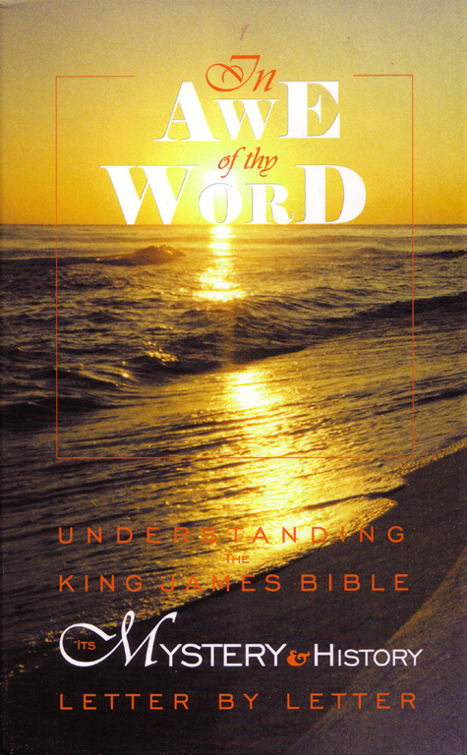
Every word of God is pure:
Pro. 30:5

Slide 38
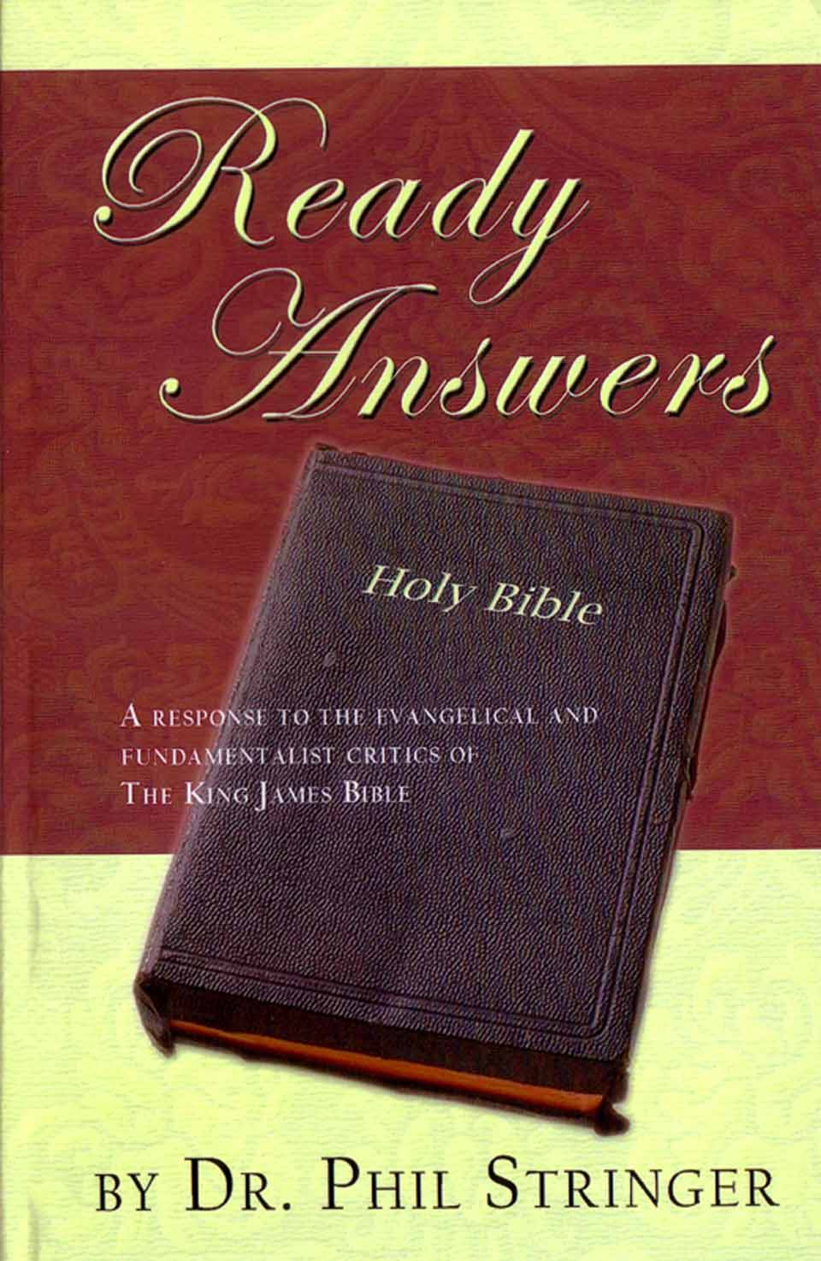
Every word of God is pure:
Pro. 30:5

Slide 39
The Bible the Word of God;
Read it and do what it says!

Slide 40
(KJV) Eph 3:9 And to make all men see what is the fellowship of the mystery, which from the BEGINNING of the world hath been hid in God, who created all things BY JESUS CHRIST:
(NIV) ... which for AGES PAST was kept hidden in God, who created all things. [by nobody]
(NASB) ... which for AGES has been hidden in God who created all things; [by nobody]

Slide 41
(KJV) Eph 3:9 And to make all men see what is the fellowship of the mystery, which from the BEGINNING of the world hath been hid in God, who created all things BY JESUS CHRIST:
(ASV) ... which for AGES hath been hid in God who created all things; [by nobody]
(RSV) ... mystery hidden for AGES in God who created all things; [by nobody]

Slide 42
(KJV) Eph 3:9 And to make all men see what is the fellowship of the mystery, which from the BEGINNING of the world hath been hid in God, who created all things BY JESUS CHRIST:
(ESV) ... mystery hidden for AGES in God who created all things, [by nobody]
(NLT) ... God, the Creator of all things, had kept secret from the beginning. [by nobody]

Slide 43
(KJV) Eph 3:9 And to make all men see what is the fellowship of the mystery, which from the BEGINNING of the world hath been hid in God, who created all things BY JESUS CHRIST:
(CEV) God, who created everything [by nobody], wanted me to help everyone understand the mysterious plan that had always been hidden in his mind.
(NKJV) ... which from the beginning of the AGES has been hidden in God who created all things THROUGH Jesus Christ;

Slide 44
(KJV) Gen 6:13 And God said unto Noah, The end of ALL FLESH is come before me; for the earth is filled with violence through them; and, behold, I will destroy them with the earth.
All flesh of land dwellers that breathed from their nostrils died (as explained in 7:21-23).
(NIV) Gen 6:13 So God said to Noah, "I am going to put an end to all PEOPLE, ...
(CEV) Gen 6:13 So he told Noah: Cruelty and violence have spread everywhere. Now I'm going to destroy the whole earth and all its PEOPLE.
(AMP) Gen 6:13 God said to Noah, I intend to make an end of all flesh, for through MEN the land is filled with violence; and behold, I will destroy them and the land.
These modern versions either say or imply that the flood is limited to killing people, not animals.

Slide 45
(KJV) Prov 26:10 The great God that FORMED ALL THINGS both rewardeth the fool, and rewardeth transgressors.
(NIV) 26:10 Like an archer who wounds at random is he who hires a fool or any passer-by.
(NASB) 26:10 Like an archer who wounds everyone, So is he who hires a fool or who hires those who pass by.
(AMP) [But] like an archer who wounds all, so is he who hires a fool or chance passers-by.
(NLT) An employer who hires a fool or a bystander is like an archer who shoots recklessly.

Slide 46
(KJV) Prov 26:10 The great God that FORMED ALL THINGS both rewardeth the fool, and rewardeth transgressors.
(ESV) Like an archer who wounds everyone is one who hires a passing fool or drunkard.
(CEV) It's no smarter to shoot arrows at every passerby than it is to hire a bunch of worthless nobodies.
(ASV) As an archer that woundeth all, So is he that hireth a fool and he that hireth them that pass by.
They've removed God as the creator and replaced Him with some kind of Robin Hood or William Tell shooting arrows at drunks and fools.

Slide 47
GOD FORMED JESUS CHRIST?
(KJV) Prov 8:22-23 The LORD possessed me in the beginning of his way, BEFORE his works of old. 23 I was set up from everlasting, from the beginning, or ever the earth was.
(NIV) The LORD *brought* me forth as the first of his WORKS, ...
(AMP) The Lord *formed* and brought me [Wisdom] forth at the beginning of His way, before His acts of old.
(NLT) The LORD *formed* me from the beginning, before he created anything else.
Why do we see this theme over and over in the modern versions that Jesus Christ is just another created creature instead of the Creator Himself? Who would want to demote Jesus Christ like that?

Slide 48
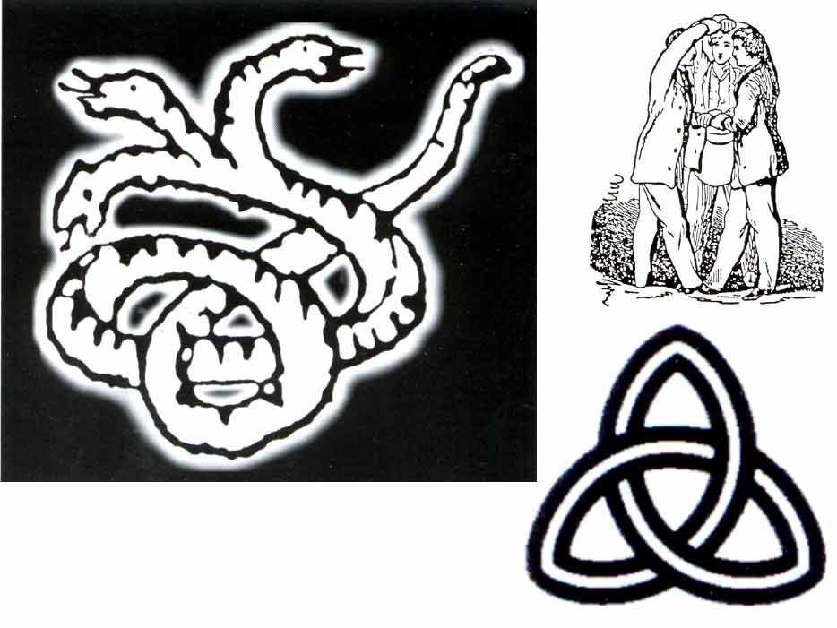
New KJV logo

Slide 49

See: www.av1611.org

Slide 50
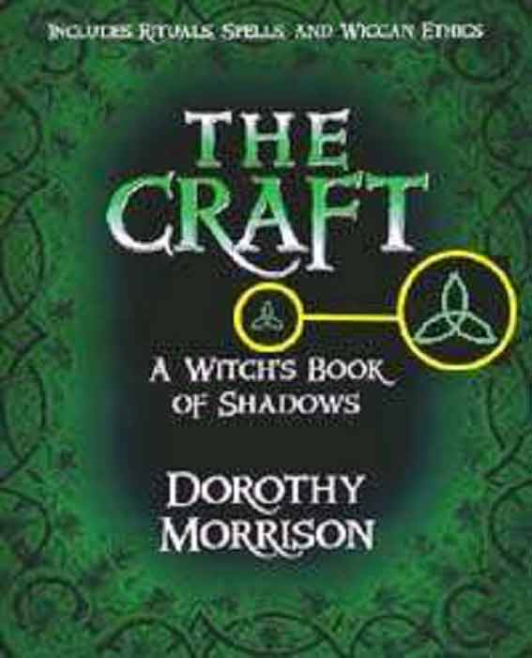

Slide 51
The grass withereth, the flower fadeth: but the word of our God shall stand for ever.
Is. 40:8

